Slide 1
Regression interpretation

Slide 2
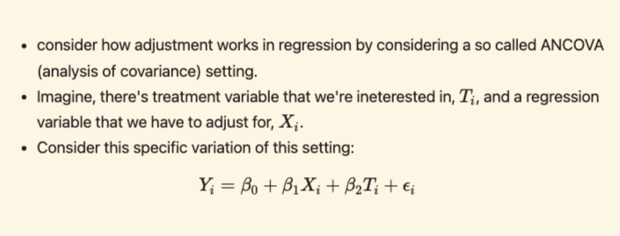
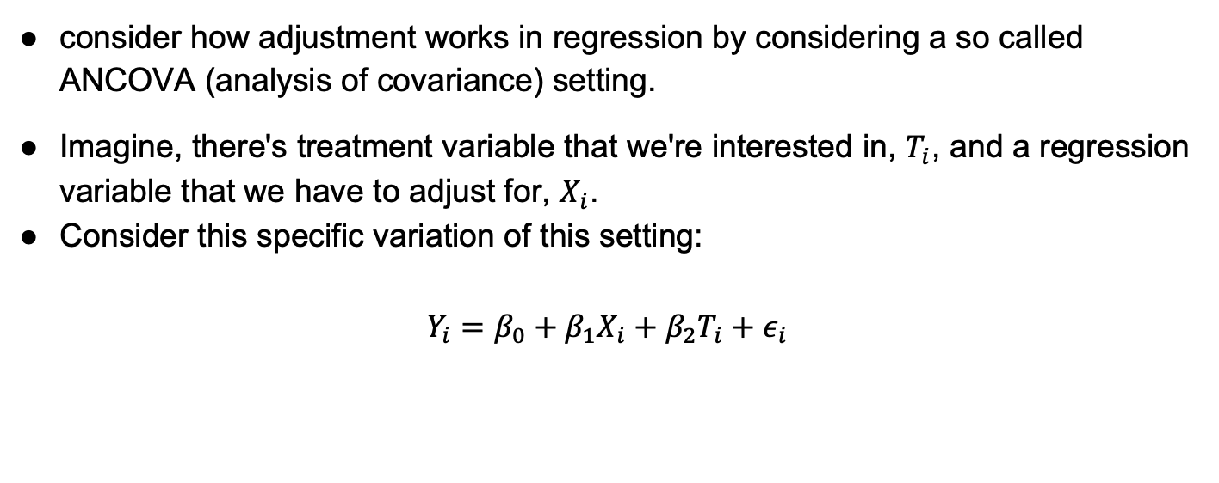
consider how adjustment works in regression by considering a so called ANCOVA (analysis of covariance) setting.
Imagine, there's treatment variable that we're interested in, $T_{i}$, and a regression variable that we have to adjust for, $X_{i}$.
Consider this specific variation of this setting:
$$Y_{i}=β_{0}+{β_{1}X}_{i}+{β_{2}T}_{i}+ε_{i}$$

Slide 3
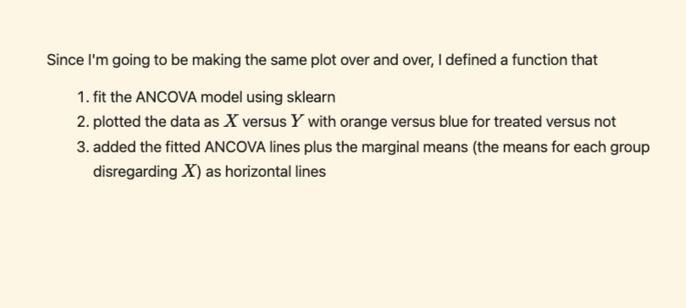
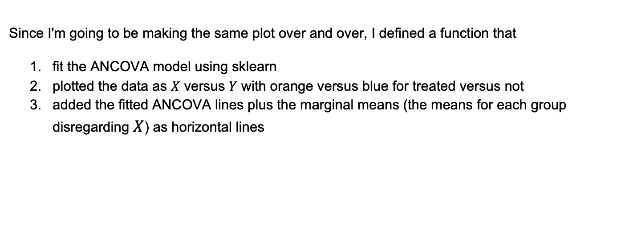
Since I'm going to be making the same plot over and over, I defined a function that
fit the ANCOVA model using sklearn
plotted the data as $X$ versus $Y$ with orange versus blue for treated versus not
added the fitted ANCOVA lines plus the marginal means (the means for each group disregarding $X$) as horizontal lines

Slide 4
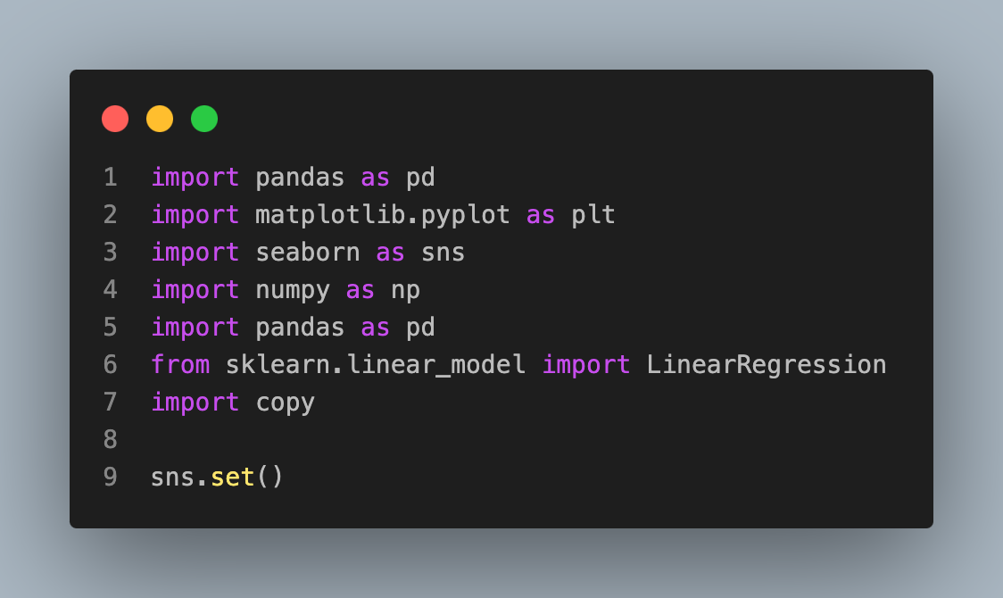
Imports

Slide 5
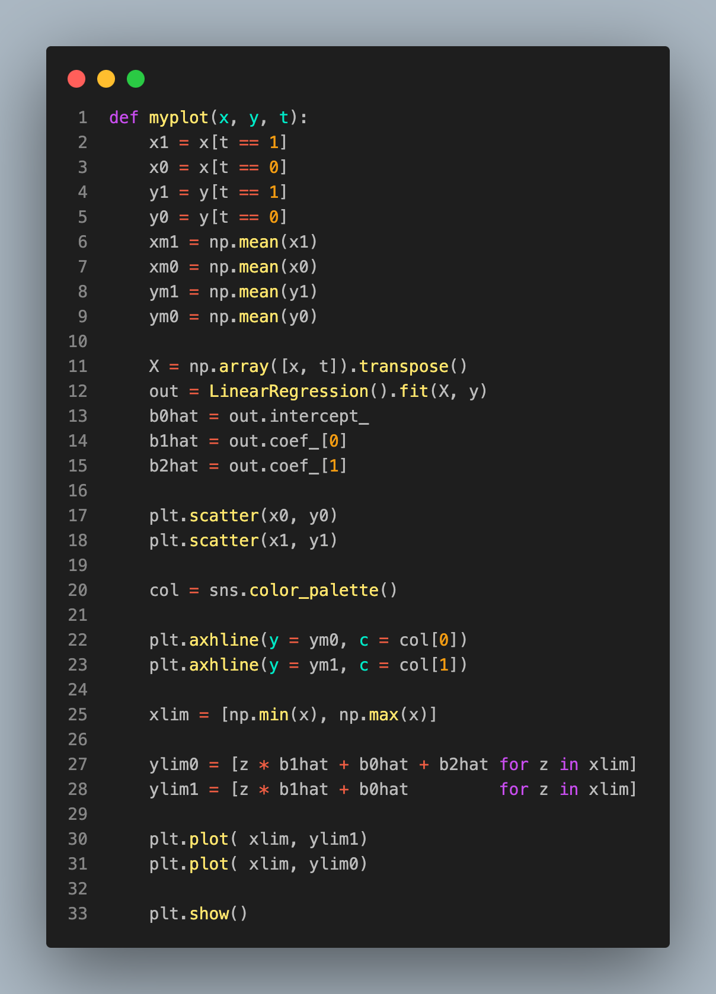
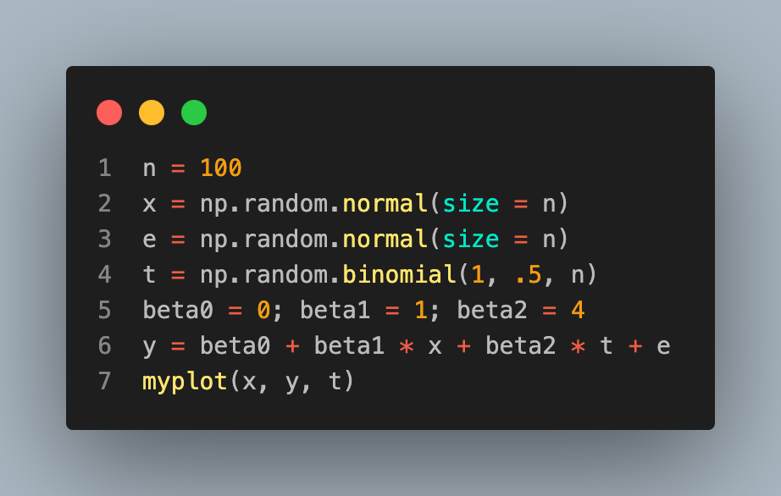
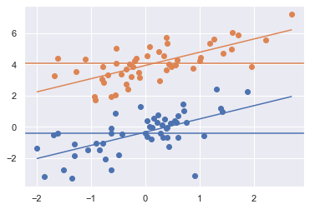

Slide 6
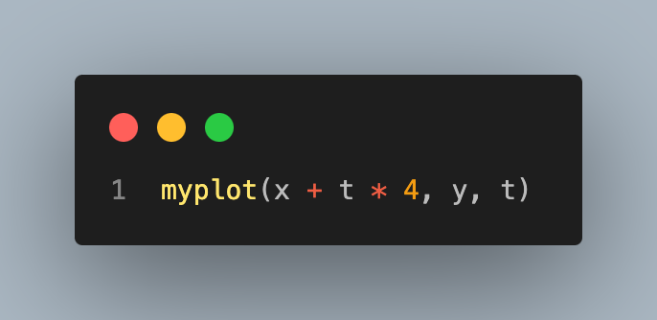
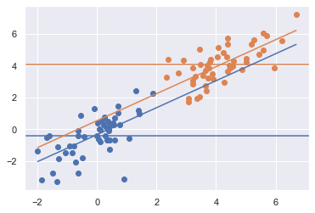

Slide 7
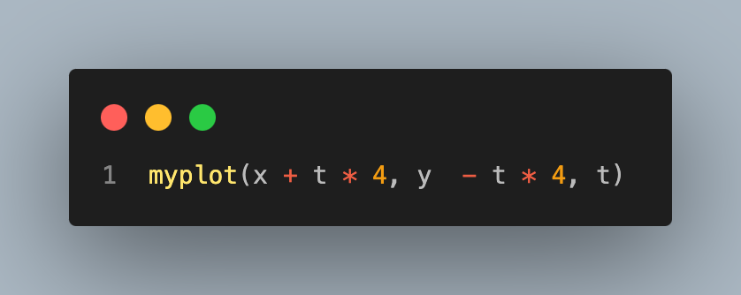
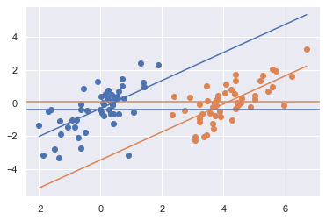

Slide 8

